Slide 1
Intro to R for MM325

Slide 2
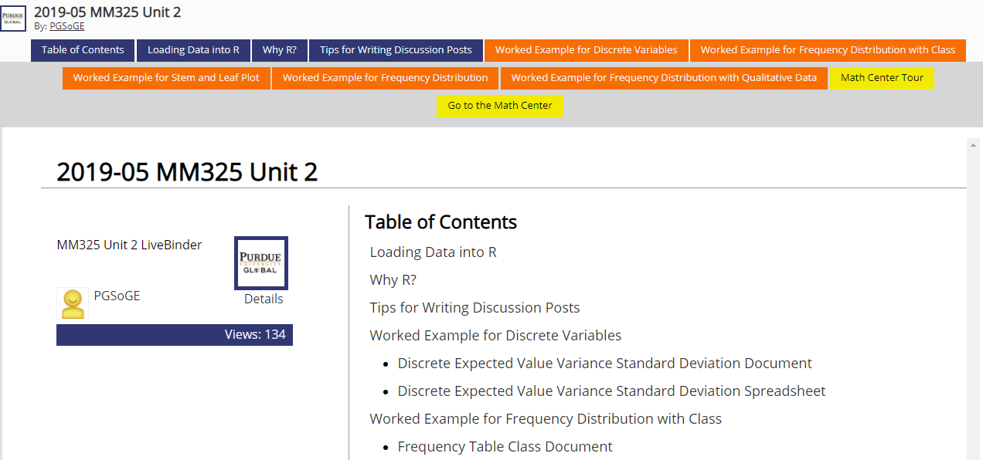
LiveBinder

Slide 3
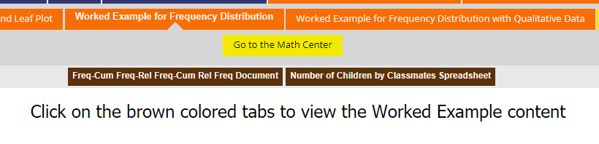
Worked Examples

Slide 4
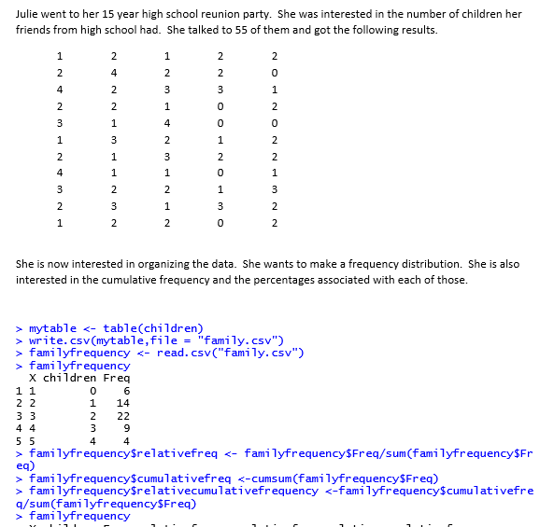
Code

Slide 5
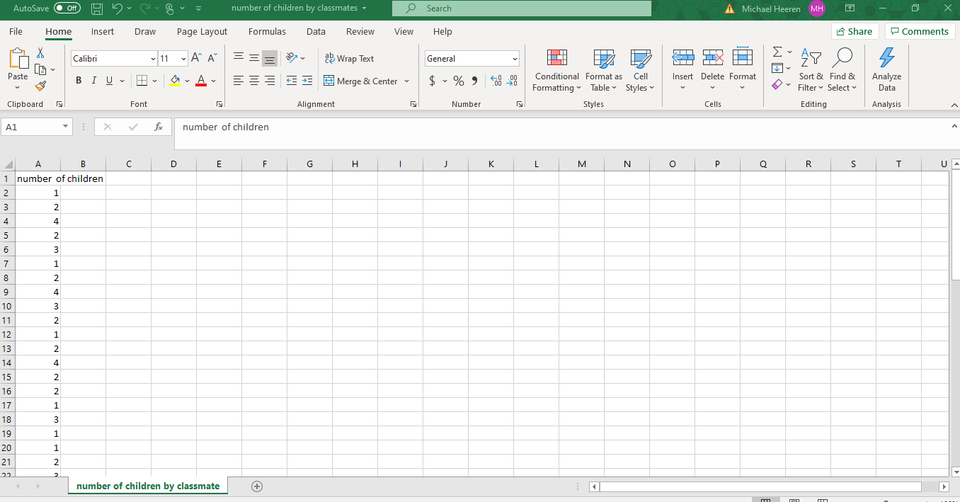
Spreadsheets used with code provided

Slide 6
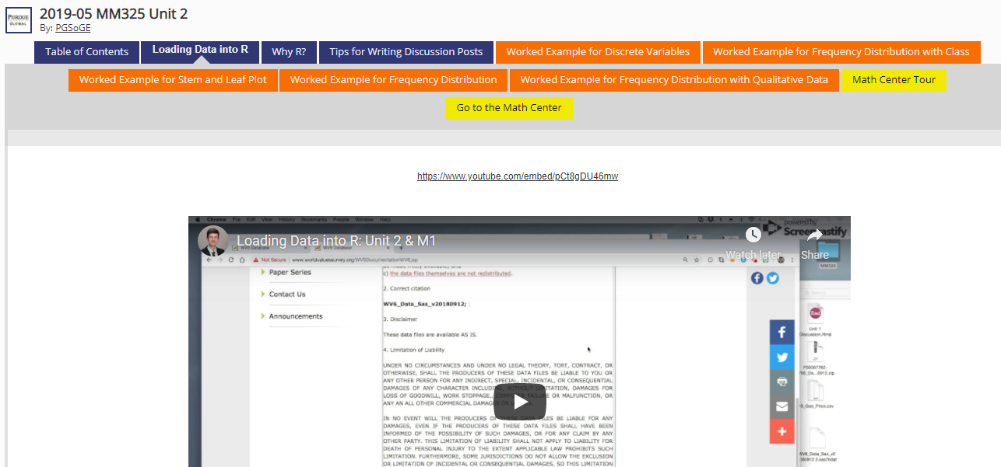
Videos in the LiveBinder

Slide 7
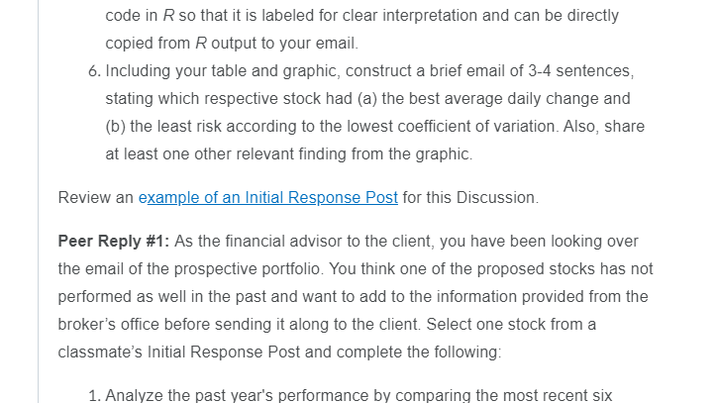
Examples in Discussion

Slide 8
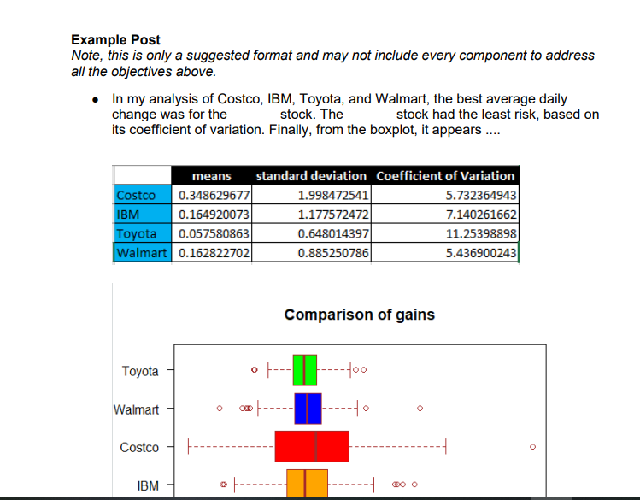
Output

Slide 9
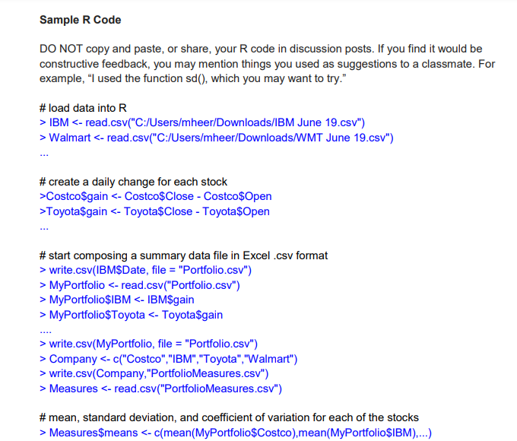
Code to generate output

Slide 10
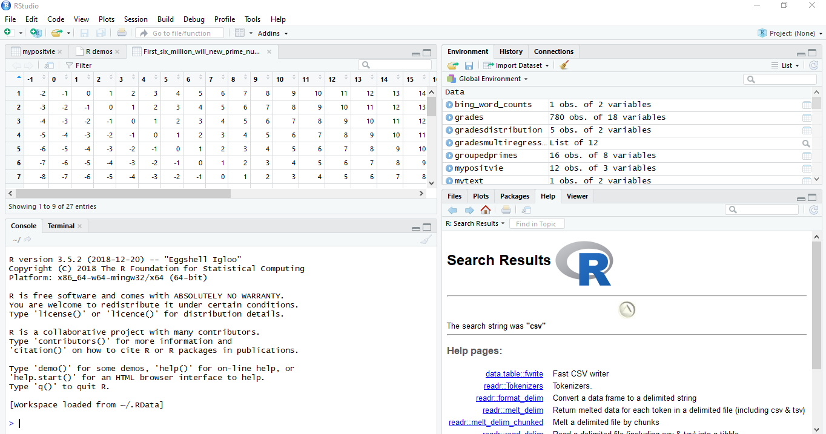
Inside of R Studio

Slide 11
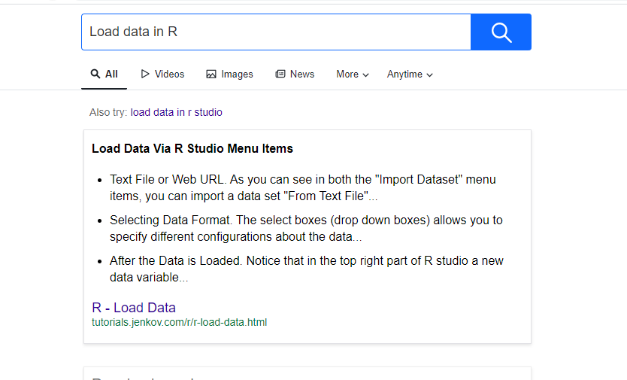
Search on the Internet

Slide 12


Tutors

Slide 13
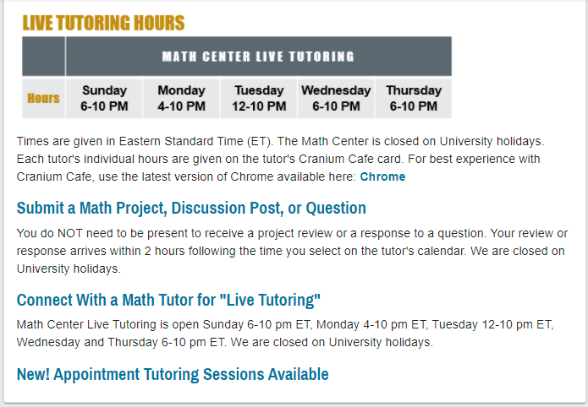
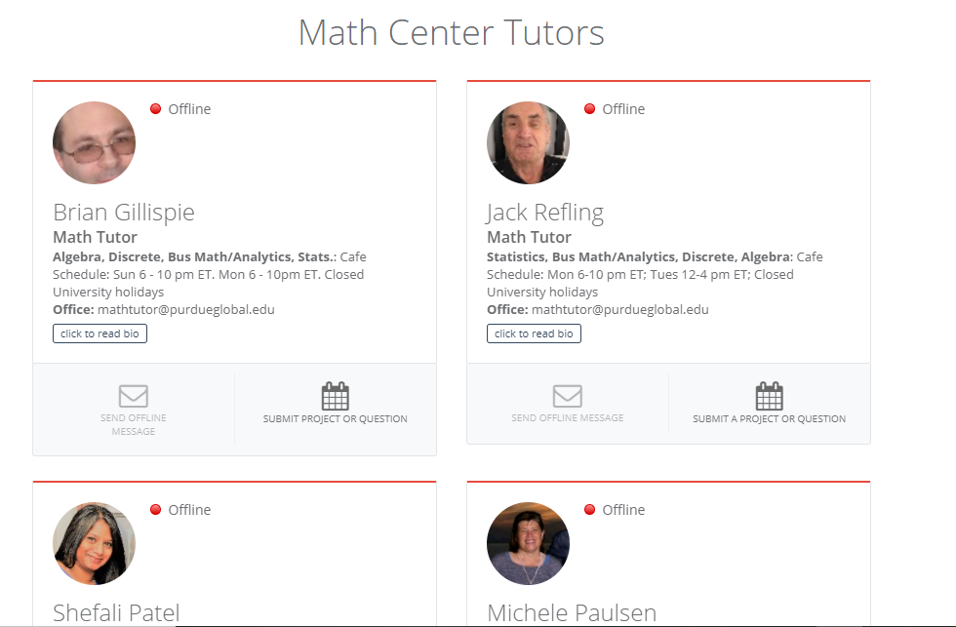

Slide 14
Start Early!
Finding code
Applying code
Debugging code

